Slide 1


Smart Plant Monitoring System using RuggerdBoard A5D2X
Made By :- Aayushi Samantsinghar
Debasis Maharana
Nagen Bihari
Premanshu Dash
Jyoti Prakash Behera

Slide 2
To Develop a Real-time Plant monitoring system that measures key parameters like soil moisture, temperature, humidity, and light intensity using the Rugged Board A5D2X, and displays or transmits this data to a user-friendly interface for selective plant health management.
Smart Plant Monitoring System
🔍Objective
Of the Project

Slide 3
Plants require specific environmental conditions for optimal growth. Monitoring these parameters in real time helps automate irrigation and improve plant care. The Rugged Board A5D2X (an industrial-grade SBC based on Microchip SAMA5D2 processor) oers a powerful and reliable platform for embedded monitoring systems.Advanced sensors like a pH sensor and rain sensor make the system more robust and practical for smart agriculture.
Smart Plant Monitoring System
🧠Overview
Of the Project

Slide 4
Rugged Board A5D2X
WiFi Module ( WE-10 )
Soil Moisture Sensor (HW108) Module
AHT25 (Temperature + Humidity ) Sensor
Servo Motor
Relay Module (for automatic irrigation)
Water Pump
12V Power Supply
Resistors, Breadboard, Connecting wires
Smart Plant Monitoring System
🔧Hardware Components

Slide 5
Rugged Board A5D2X :- A powerful, Linux-based embedded development board with multiple I/O interfaces, ideal for industrial and IoT applications. It processes sensor data and controls actuators in the plant monitoring system.
Wi-Fi Module (WE-10) :- A compact, plug-and-play Wifi module compatible with Rugged Board, used to send data to the cloud for remote monitoring and IoT integration.
Soil Moisture Sensor (HW080) :- A capacitive-type sensor that detects the water level in the soil. It provides analog output and is corrosion-resistant, making it reliable for long-term use.
AHT25 Sensor (Temperature + Humidity Sensor) :- A digital sensor that accurately measures ambient temperature and humidity. It helps the system decide when to activate the water pump based on climate conditions.
Smart Plant Monitoring System
🔧Hardware Components Details

Slide 6
Servo Motor :- A small motor used to control the angle of a shading device. It rotates when light intensity is too high, protecting the plant from excessive sunlight.
Relay Module (for automatic irrigation) :- Acts as an electrically operated switch to control the water pump based on signals from the Rugged Board. It enables safe switching of high-power devices.
Water Pump :- A 12V DC pump used to supply water to the plant. It is activated by the relay when soil moisture is low and temperature/humidity conditions are critical.
12V Power Supply :- Provides electrical power to all modules, especially high-power components like the pump and relay.
Resistors, Breadboard, and Connecting Wires :- These are basic electronic components used to build the circuit, ensure proper voltage levels, and connect sensors and actuators to the board without soldering.
Smart Plant Monitoring System
🔧Hardware Components
Details

Slide 7
1. Embedded Linux (running on Rugged Board)
2. C Language (for sensor interfacing)
3. MQTT Protocol (for IoT cloud interface)
4. Rightech Cloud ( for showing the data )
Smart Plant Monitoring System
💻 Software Requirements

Slide 8
Embedded Linux (on Rugged Board) :-
A lightweight Linux OS used in embedded systems to run real-time applications. It handles sensor data processing and device control efficiently.
C Language (for Sensor Interfacing) :-
A low-level language ideal for embedded programming. Used to read sensors, control hardware, and manage logic on the Rugged Board.
MQTT Protocol (for IoT Cloud Interface) :-
A lightweight messaging protocol for IoT communication. It sends sensor data to the cloud using publish-subscribe model.
Rightech Cloud (for Showing the Data) :-
An IoT cloud platform for device data visualization and monitoring. It displays real-time sensor values received from the system.
Smart Plant Monitoring System
💻 Software Requirements
Details

Slide 9
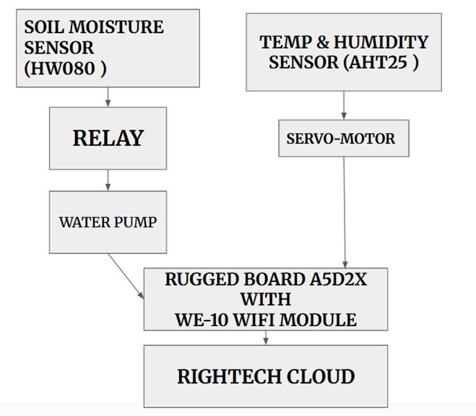
Smart Plant Monitoring System
🔁 System Architecture

Slide 10
a) Sensors Collect Data :-
○ Soil Moisture (HW103): Detects dryness level in the soil.
○ Temperature/Humidity (AHT25): Monitors ambient temperature and humidity conditions.
b) Processing on Rugged Board A5D2X :-
○ If soil is dry and temperature/humidity are critical, the relay triggers the water pump.
○ Servo motor is activated to move a cover if sunlight is too intense.
○ Sensor data is processed locally and can be sent to the cloud using the WE10 Wi-Fi module.
○ Data can be visualized in real-time using a web dashboard or screen interface.
Smart Plant Monitoring System
⚙️ Working

Slide 11
c) Output & Actuation :-
○ Water pump control via relay module.
○ Sunlight control via servo motor for shading.
○ Live sensor readings displayed on web or cloud dashboard.
○ Cloud integration (e.g., Rightech Cloud) enables remote monitoring and alerts.
Smart Plant Monitoring System
⚙️ Working

Slide 12
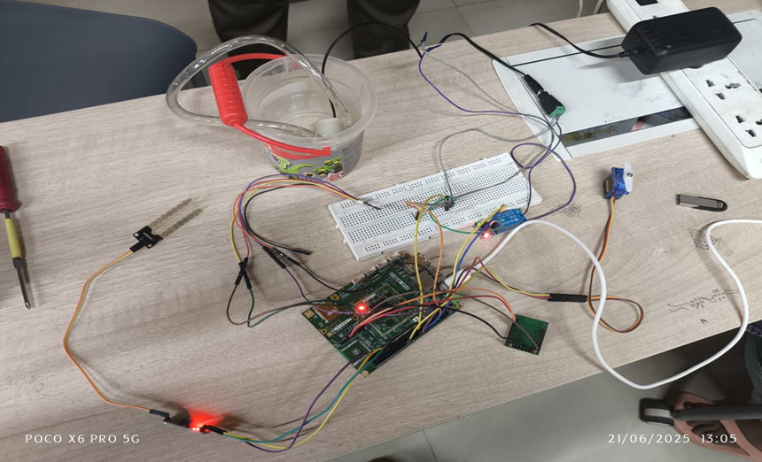
Smart Plant Monitoring System
Circuit Diagram

Slide 13
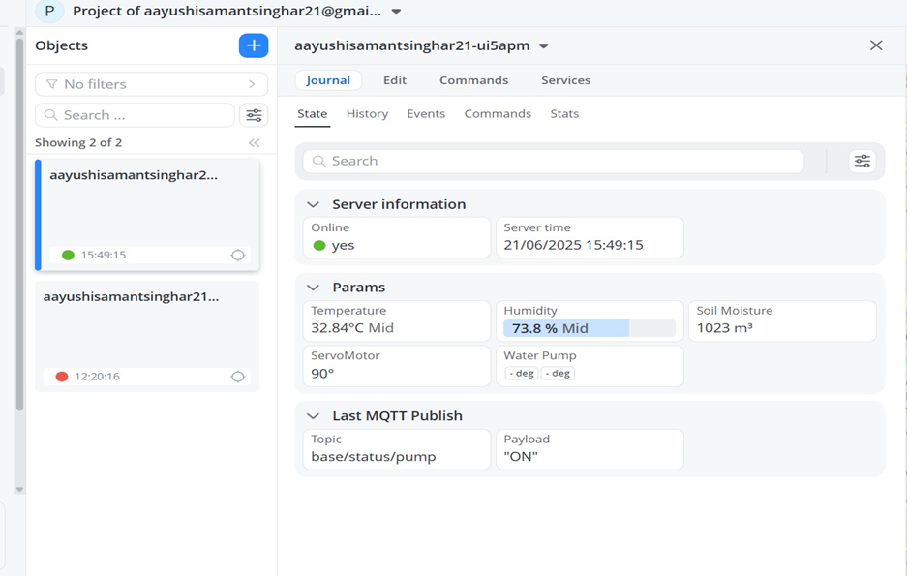
Smart Plant Monitoring System
Rightech Cloud Interfacing

Slide 14
Smart Agriculture :– Automates irrigation and environmental control in farms to improve crop yield and water efficiency.
Home Gardening : – Helps urban gardeners monitor and maintain indoor/outdoor plants automatically.
Greenhouses :– Maintains optimal growing conditions for sensitive plants in controlled environments.
Research & Education :– Used as a practical learning tool for IoT, embedded systems, and sensor integration.
Nurseries & Plant Shops: – Ensures consistent care for a large number of plants with minimal manual effort.
Landscape Irrigation :– Automates watering in lawns, parks, and public gardens based on weather and soil data.
Smart Plant Monitoring System
🌱 Applications

Slide 15
pH Sensor Integration – To monitor soil acidity/alkalinity for improved nutrient management.
Rain Sensor Addition – Prevents unnecessary irrigation when natural rain is detected.
Mobile App Integration – For remote control, alerts, and live monitoring via smartphone.
AI-Based Predictive Irrigation – Use machine learning to forecast watering needs based on weather and plant type.
Solar Power Supply – To make the system energy-efficient and suitable for remote, off-grid locations.
Voice Assistant Control – Integrate with Alexa or Google Assistant for voice-activated monitoring.
Camera Integration – For visual monitoring and plant health analysis using image processing.
Smart Plant Monitoring System
🚀 Future Enhancements

Slide 16
The Smart Plant Monitoring System using Rugged Board A5D2X is a practical and efficient solution for automating plant care using IoT and embedded technologies. By integrating sensors for soil moisture, temperature, humidity, and light intensity with actuators like a servo motor and water pump, the system ensures optimal conditions for plant growth with minimal human intervention. The use of cloud connectivity through the WE-10 Wi-Fi module and Rightech Cloud enables real-time data monitoring and remote management. This project not only promotes sustainable water usage and smart agriculture but also serves as a valuable educational tool for learning embedded systems and IoT applications. With potential for further enhancements like mobile integration and AI-based automation, this system represents a strong step toward modern, intelligent farming and environmental management.
Smart Plant Monitoring System
Conclusion

Slide 17
THANK YOU !!
1. Embedded Linux (running on Rugged Board) 2. Python / C (for sensor interfacing) 3. MQTT or HTTP (for IoT cloud interface, optional) 4. Rightech Cloud ( for showing the data )
1. Embedded Linux (running on Rugged Board) 2. Python / C (for sensor interfacing) 3. MQTT or HTTP (for IoT cloud interface, optional) 4. Rightech Cloud ( for showing the data )

